Slide 1
Artificial Intelligence
Dr. Meghana Harsh Ghogare

Slide 2
Definition
Artificial intelligence is the simulation of human intelligence processes by machines.
What is AI
(AI) is the ability of a computer or a robot controlled by a computer to do tasks that are usually done by humans

Slide 3
Diffrence between AI and ML
AI –Engineering of making Intelligent Machines and Programes
ML-Ability to learn without being explicitly programmed

Slide 4
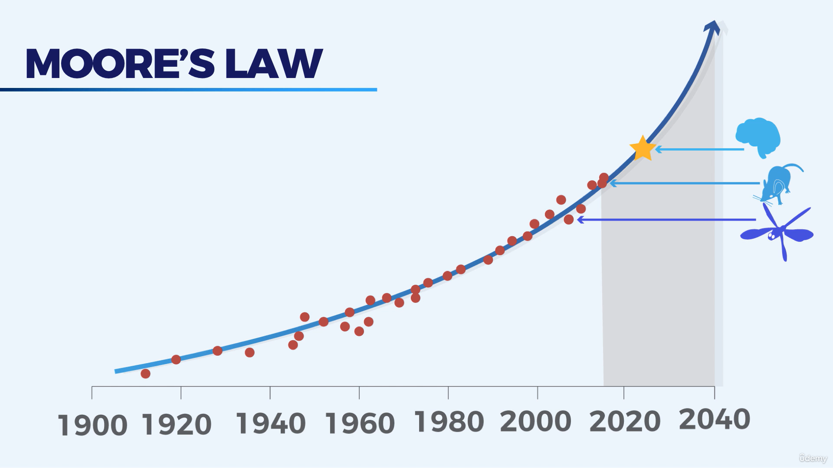

Slide 5
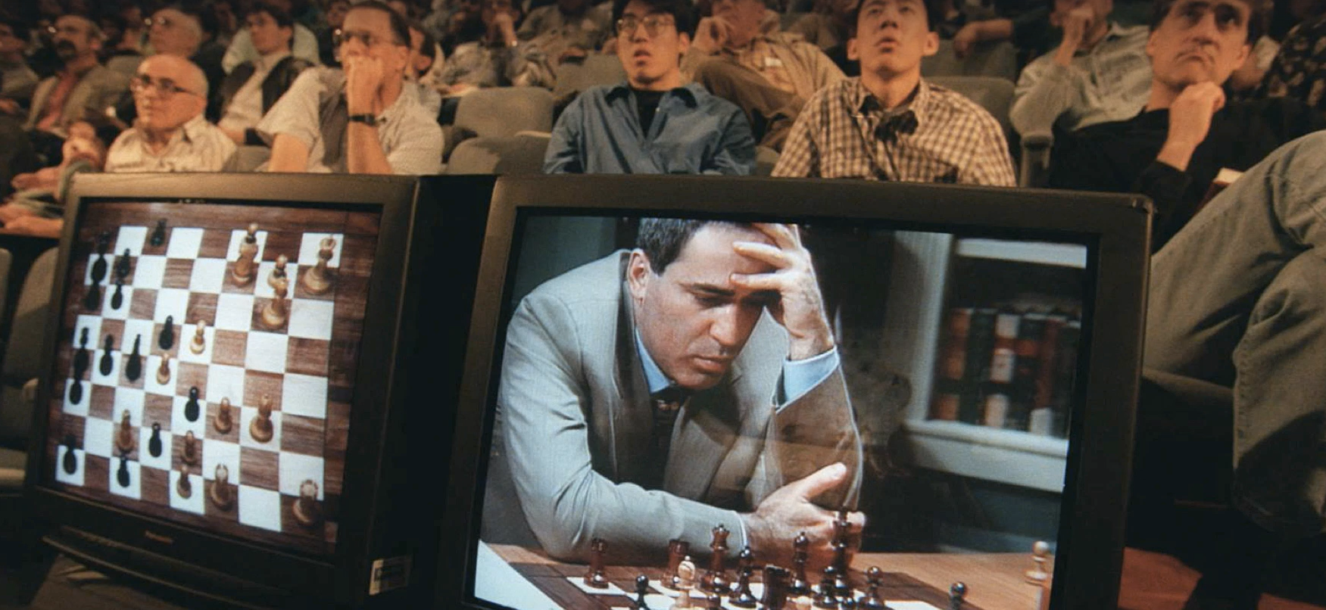
In 1997 Deep Mind was the first AI to beat Garry Kasparov in Chess.
Most widely telecasted game ever

Slide 6
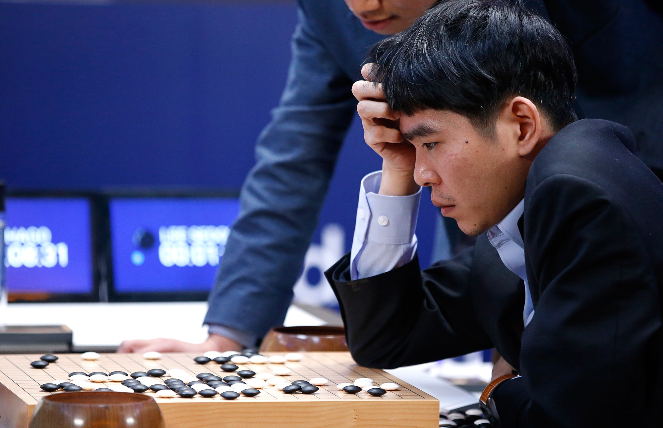
Lee Sedol 18 times world champion in Go Chess was defeated by AI AlphaGo
Complex than Chess, China Japan & Korea

Slide 7
We use games to train AI
Games are a confined Environment,
If we can beat a game than same principals can be applied to Business

Slide 8
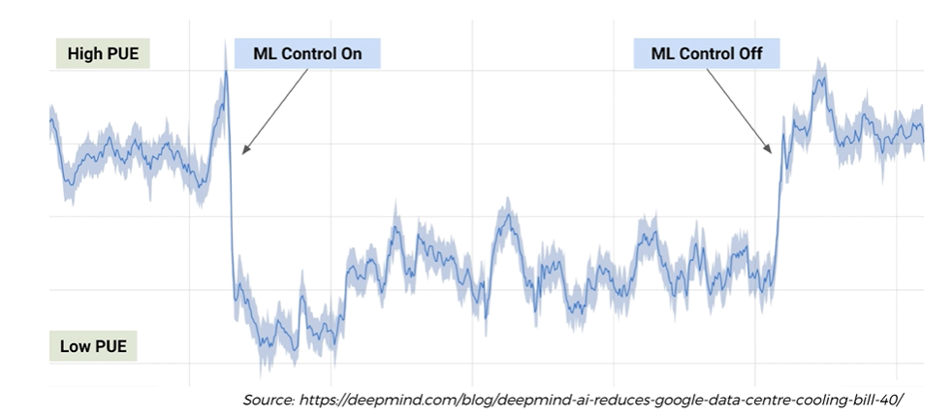
They applied artificial intelligence to a Google warehouse to control the air cooling
As soon they switch on the AI, it goes down.
And then they switch it back off, it goes up.
They were able to save 40%
on their electricity bill,

Slide 9
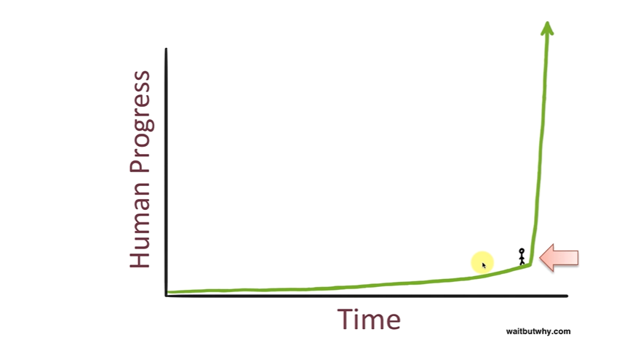

Slide 10
Chat GPT
https://chat.openai.com/
The full form of GPT is "Generative Pre-trained Transformer." GPT is a type of deep learning model that uses a transformer architecture and is trained on large amounts of text data to generate human-like responses
Best library for web scraping data
Syntax error
Error message
I have a dataset named data.csv with a dependent variable in the last column and an index in the first column. Can you please write a python code that builds a logistic regression model and trains it on this dataset. Also please return accuracy at the end

Slide 11
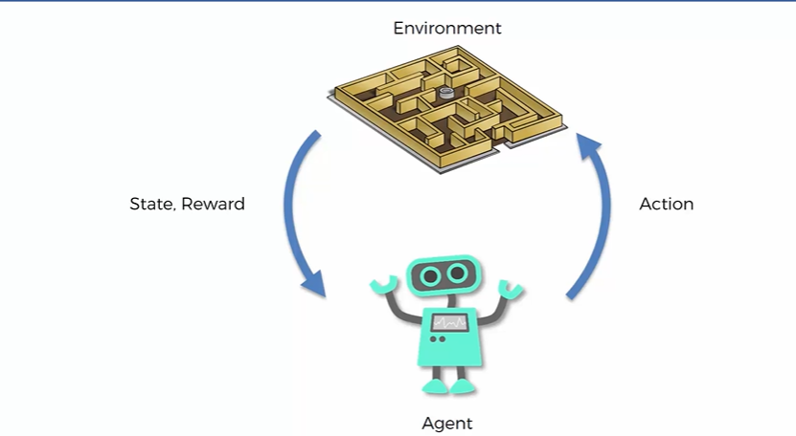
What is Reinforcement Learning

Slide 12
maze is our representation of an environment.
agent is our artificial intelligence, it will be learning from the feedback
is the agent performs certain actions in this environment.
And as a result, the state will change
Based upon the action it gets a reward +/-
It learns from the feedback
Actions leading to bad rewards and sates are avoided
Driving a car and policeman is a feedbback
Training a Dog

Slide 13
Major Areas of AI
Computer vision
Fuzzy logic
Expert systems
Robotics
Machine learning
Neural networks/deep learning
Natural language processing

Slide 14
Computer Vision
techniques used computer to understanding digital images and videos
Uses ML to identify objects, faces, people, animals etc.
CNN breaks images down into pixels, giving them tags
The neural network then uses the labels to conduct convolutions and make predictions about what it sees.
Object tracking
Image classification
Facial recognition

Slide 15
Fuzzy Logic
copies human decisions by considering all existing possibilities between digital values of ‘yes’ and ‘no’.
Washing Machine
Expert systems
is a program specializing in a singular task, just like a human expert.
Eg: CaDeT, a diagnostic support system help detecting cancer in its early stages.
Robotics
help humans with tedious and repetitive tasks,
Industry, Space exploration, Sophia

Slide 16
Machine learning
ability of machines to automatically learn from data and algorithms
Supervised learning
UnSupervised learning
Reinforcement learning
Neural networks/deep learning
consisting of an input layer, one or more hidden layers, and an output layer.
Natural language processing
allows computers to understand both text and spoken words like humans can
Virtual chatbots, Spam detection, Sentiment analysis

Slide 17
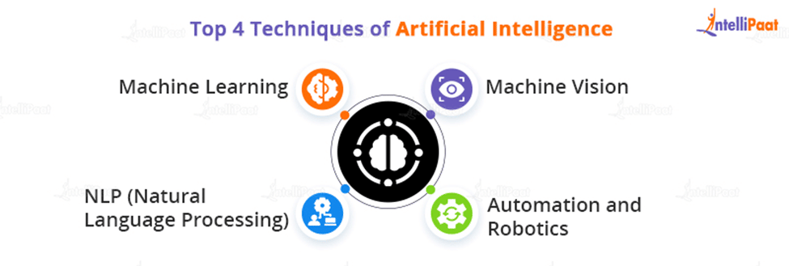
AI Techniques

Slide 18
AI History
1950- Allan Turing –Turing test( a test of intelligence of computer, a human should not be unable to distinguish between a machine and human. Eg: chatbots
1951, Isaac Asimov proposed the Three Laws of Robotics.
1955, the first AI-based software was created
In 1959, the first self-learning video game
1964 The first robot is installed on the GM assembly line
1974 the first chatbot Eliza
1997, IBM’s Deep Blue chess program defeated Garry Kasparov
2004 first emotional AI in 2004
2010 Google begins developing a self-driving automobile. IBM Watson defeats the champions of Jeopardy that year. Siri, Google Now, and Cortana have gained popularity.

Slide 19
AI Problems
Safety: The self-improving AI systems can become so mighty than humans that could be very difficult to stop from achieving their goals, which may lead to unintended consequences.
Data Privacy and Security: An AI program that recognizes speech and understands natural language is theoretically capable of understanding each conversation on e-mails and telephones.
Human-level
Trust Deficit
Computing Power
Insufficient Data (sufficient amount of data is needed to train the model)
Job Loss Concerns
Threat to Human Dignity: nursing, surgeon, judge, police officer, etc.

Slide 20
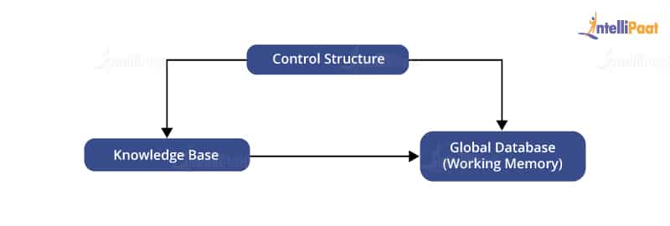
Production System
Production systems are computer programmes, It consists of a set of rules as the system reacts to external conditions.
Condition --------→ Action
Components of a Production System in AI

Slide 21
Global Database
A database contains all the necessary data and information required for the successful completion of a task.
It can be divided into two parts as
Permanent (consists of fixed actions) and temporary(part alters according to circumstances).
Production Rules : rules operate on the global database.
Each rule consists of a precondition and postcondition that the global database either meets or not. For example, if a condition is met by the global database, then the production rule is applied successfully.
Control System: decides which production rule should be applied. It stops computation when a termination condition is met

Slide 22
What are the Features of a Production System?
A production system has the following features:
Simplicity: Due to the use of the IF-THEN structure, each sentence is unique and Simple
Modularity: The code is in discrete pieces, which makes it easy to add, modify, or delete the information without any side effects.
Modifiability: Easy to Modify because defined in the skeletal form and then modified to suit an application.
Knowledge-intensive: As the name suggests, the system only stores knowledge to solve the problem

Slide 23
Problem Characteristics
To choose an appropriate solution we need to categorize the problem based on the following characteristics.
Is the problem decomposable into small sub-problems which are easy to solve?
The decomposable problem can be solved easily.
Can solution steps be ignored or undone?
Eg In the 8-Puzzle, Moves can be undone and backtracked Recoverable problems.
Irrrecoverable
Is the universe of the problem is predictable?
Playing Bridge, We cannot know exactly where all the cards are or what the other players will do on their turns. For uncertain-outcome problems, a sequence of generated operators can only have a good probability of leading to a solution. Plan revision is made as the plan is carried out and the necessary feedback is provided.
For certain-outcome problems, planning can be used to generate a sequence of operators that is guaranteed to lead to a solution.

Slide 24
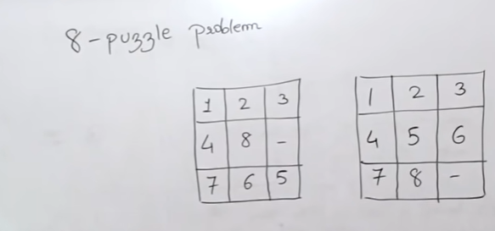

Slide 25
Is a good solution to the problem is absolute or relative?
Asolute without campareing
Relative with camparision
Is the solution to the problem a state or a path?
The Water Jug Problem, the path that leads to the goal must be reported.
What is the role of knowledge in solving a problem using artificial intelligence?
Does the task of solving a problem require human interaction?

Slide 26
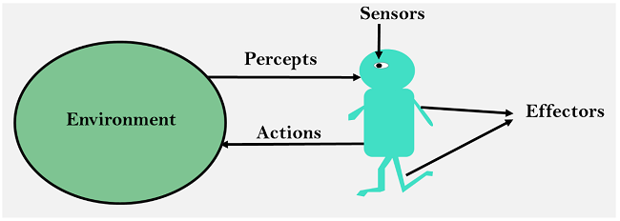
Intelligent Agent
entity which act upon an environment using sensors and actuators for achieving goals. An intelligent agent may learn from the environment to achieve their goals. A thermostat(a device that automatically regulates temperature, or that activates a device when the temperature reaches a certain point.
) is an example of an intelligent agent.
Following are the main four rules for an AI agent:
Rule 1: An AI agent must have the ability to perceive the environment.
Rule 2: The observation must be used to make decisions.
Rule 3: Decision should result in an action.
Rule 4: The action taken by an AI agent must be a rational action.

Slide 27
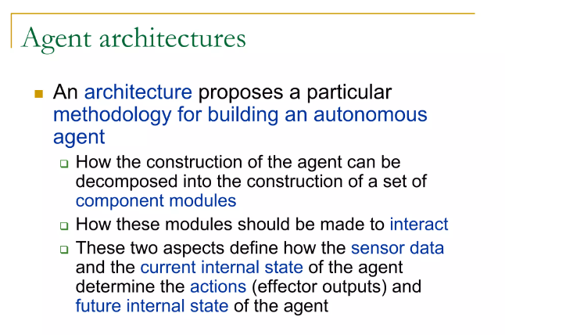

Slide 28
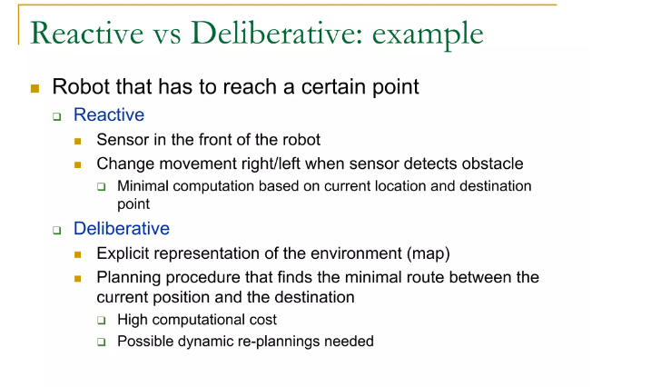

Slide 29
AI Applications(Ecommerce )
Increase in volume of voice search
chatbots
Recommendation systems
Image tagging
Personalized search
shopping from Mobile witnessing a rise(73%)
Handling fake reviews
Image Searching and Recognition
Augmented and Virtual Reality (3D presentations)
Sales Forecasting

Slide 30
AI Applications in Medicine
Error reduction in diagnosis
Reducing the costs of care
Develop drugs faster
Personalize treatment(design the right treatment plan.)
Improve gene editing
But this is just the beginning

Slide 31
AI Representation
Humans are best at understanding, reasoning, and interpreting knowledge.
But how machines do all these things comes under knowledge representation and reasoning
Following are the kind of knowledge which needs to be represented in AI systems:
Object: All the facts about objects in our world domain. E.g., Guitars contains strings, trumpets are brass instruments.
Events: Events are the actions which occur in our world.
Performance: It describe behavior which involves knowledge about how to do things.
Meta-knowledge: It is knowledge about what we know.
Facts: Facts are the truths about the real world and what we represent.
Knowledge-Base: The central component of the knowledge-based agents is the knowledge base. It is represented as KB.

Slide 32
Future Scope of AI
The scope of Artificial Intelligence is limited to domestic and commercial purposes as the medical and aviation sectors are also using AI to improve their services. If AI is outperforming human efforts, then opting for AI automation will reduce costs in the long run for a business.
Banking- customer support, enhanced data quality, fraud prevention, digital assistants etc
Health care and medicine
Jobs in AI will increase by 74

Slide 33
Issues in the design of search algorithm
The direction in which to conduct search (forward versus backward reasoning). If the search proceeds from start state towards a goal state, it is a forward search or we can also search from the goal.
How to select applicable rules (Matching). Production systems typically spend most of their time looking for rules to apply. So, it is critical to have efficient procedures for matching rules against states.
How to represent each node of the search process (knowledge representation problem).

Slide 34
Defining Problems as a State Space Search,
It has a start state, end state and all states in between the two where the answer to the problem is to be searched.
Problem: Question to be solved, It defienes the start, end and all valid states in between
State Space search: All possible states are considered in order to find the goal state with desired property
Eg: 8 Puzzle Problem

Slide 35
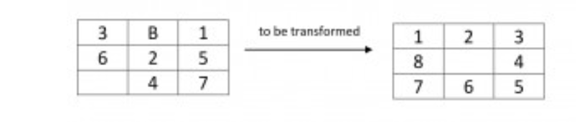
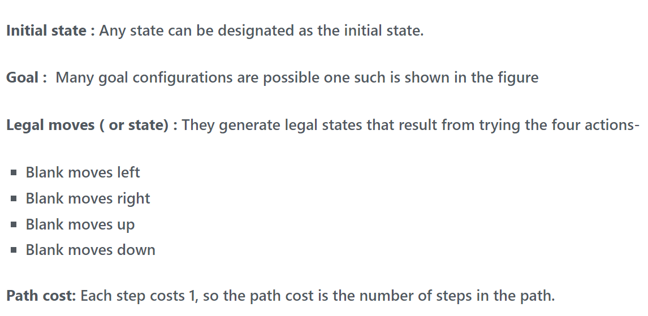

Slide 36

END
This Photo by Unknown Author is licensed under CC BY-SA

